Slide 1
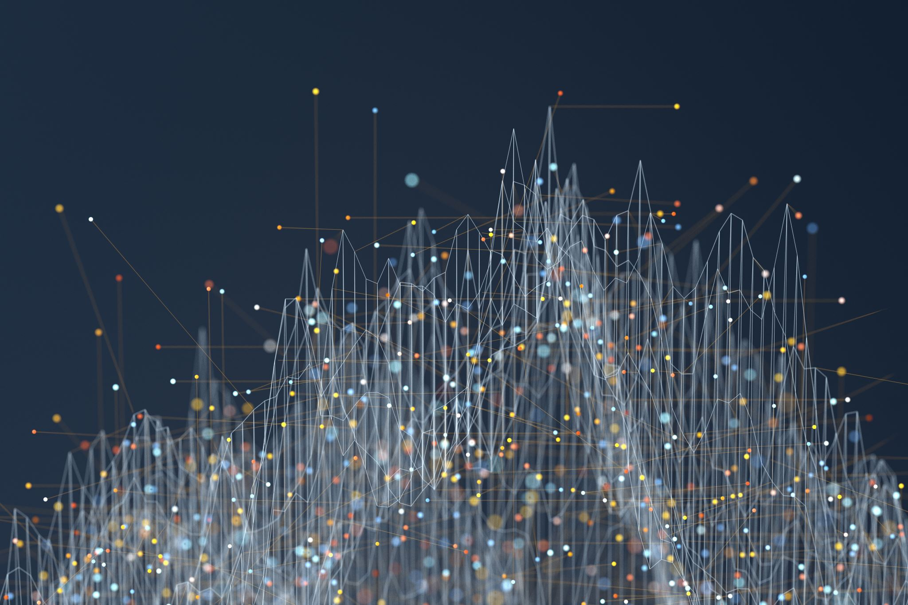
RF-Based Human Activity Recognition Using
Signal Adapted Convolution Network

Slide 2
What is Convolution Neural Network?

Slide 3
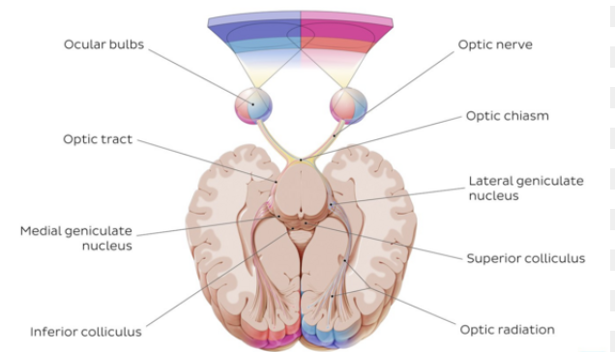
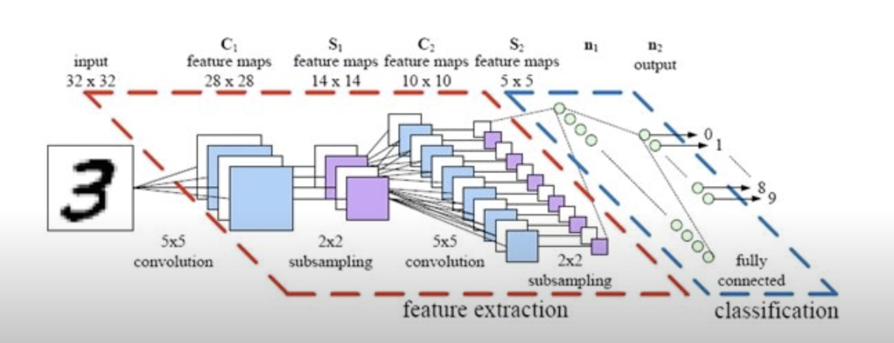
What is Convolution Neural Network(CNN)?
CNN → Artificial neural network that analyzes visual data.(imitates human optic nervous system)
vs
How human optic nervous system run?
Forward neural network
Our optic neurons have tiny local receptive field
Each local receptive field can take action with part of entire visual stimulation
If a lot of local fields get combined, humans can see entire visual images
Repeat data sampling and convolution

Slide 4
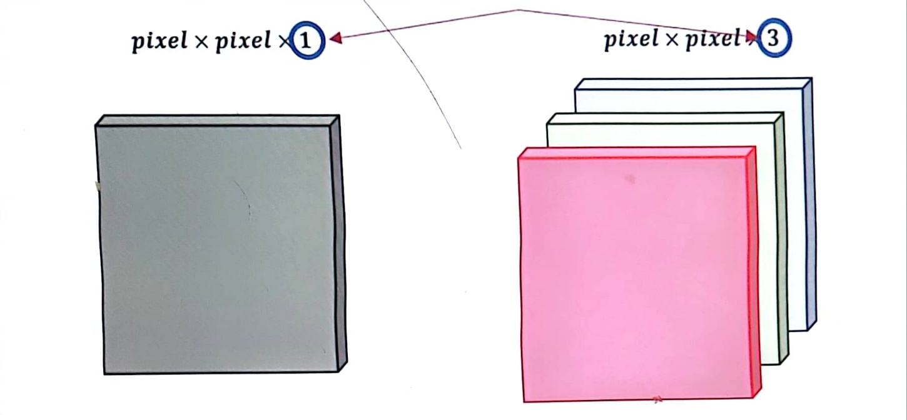
Standardization of image data
What is data standardization?
Definition of standardization:
Return the original data computer can recognize
Unit of image → pixel
Each pixel have RGB values

Slide 5
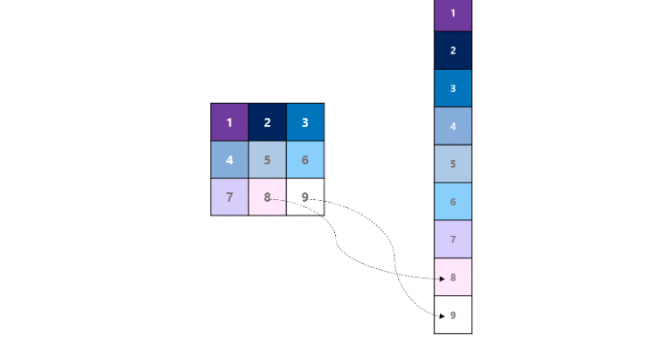

Layers of CNN-1
1. Convolution layer
Why convolution layer exist?
If we analyze the 3x3 data to flatten data,
It means ignoring the data of space,
So by operating convolution → maintain spatial data sets.
Math formula of operating convolution products

Slide 6
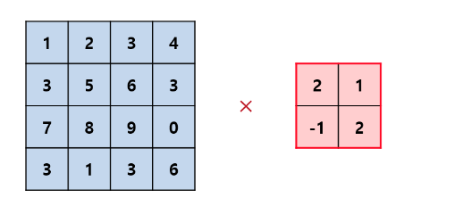
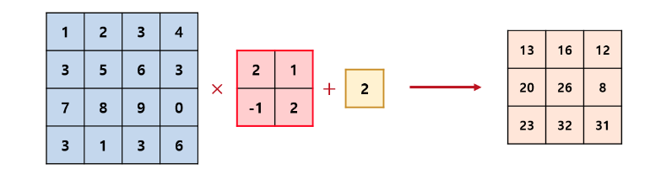
Convolutional Layer
Image
Weight/2x2 kernel
Producing each featurs

Slide 7
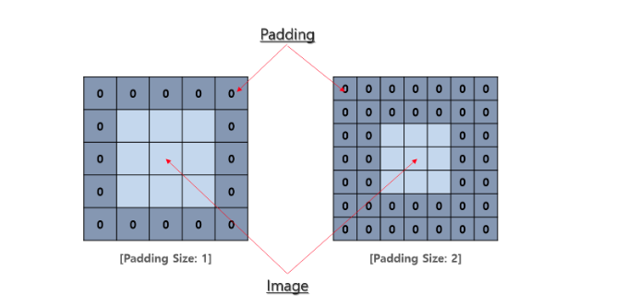
Layer of CNN-2
2. Pooling Layer
Maintaining feature of spatial data
Abstract features and features that explains entire image.
Reduce amount of learning quantities and weights
Help solving overfitting problems.
Padding
Input 0 to prevent matrix getting small and reduce loss of information on the side line of matrix

Slide 8
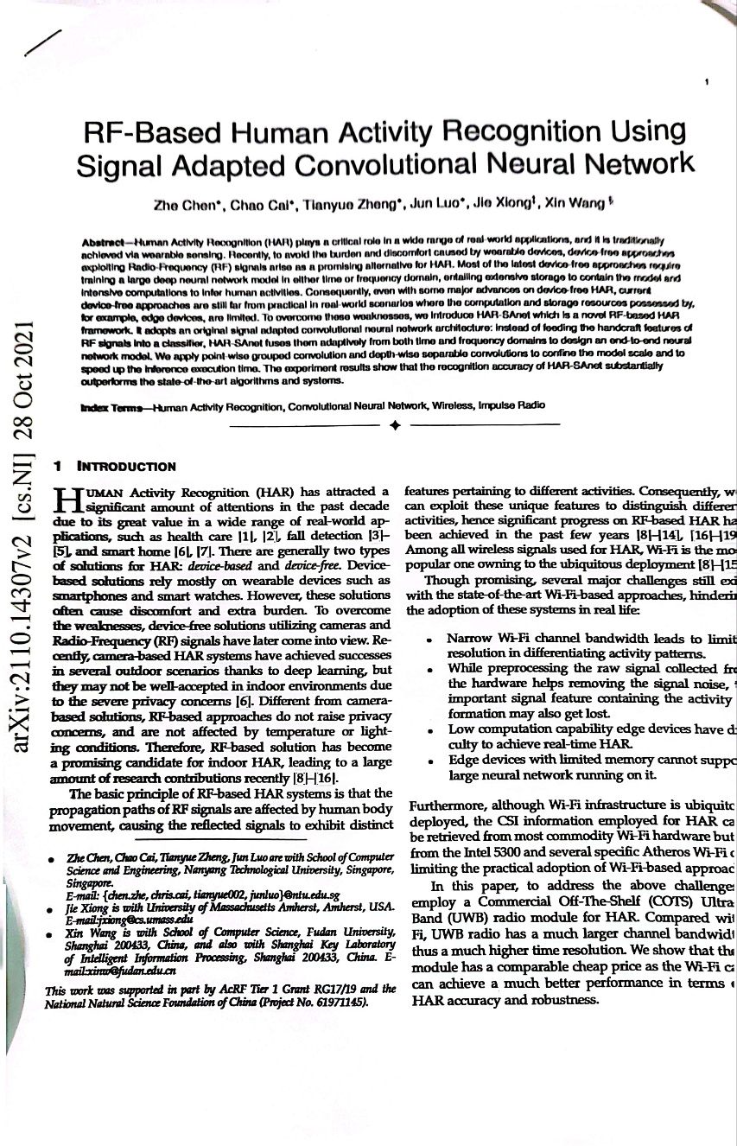
Paper Review

Slide 9
Human Activity Recognition(HAR)
Camera Based HAR
vs
RF Based HAR
Successful in indoor
Not affected by Temperature, Light
Outdoor
Not successful in indoor
Raise Concern of privacy problem

Slide 10
Big issue of HAR
How to extract stable and unique feature?
→ Use Convolutional Neural Network

Slide 11
Wifi-Limited Resolution
Frequency channel range : 20MHz ~ 80MHz(IEEE 802.11ac Wi-fi standard)
Narrow channel bandwidth limits the time domain signal resolution
→ Limits are exist in differentiating human’s action
Larger bandwidth → signal have higher chance to be separate in time domain
Using Wi-fi spectrum as input → interference, noise
Crowded channels , quality of data

Slide 12
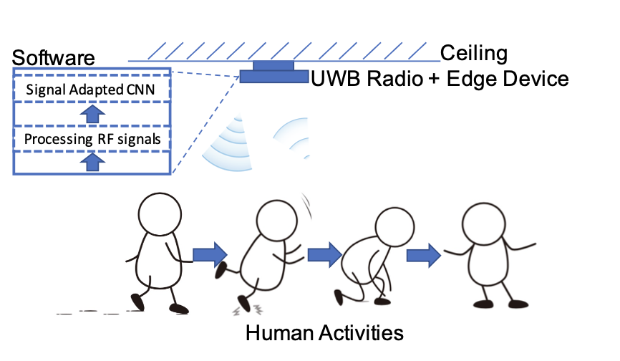
System Design
Signal Processing Module : denoising, motion, motion detection → neural network activated
non activity → classifying performance
Signal Adapted CNN: learn features of both time and frequency

Slide 13
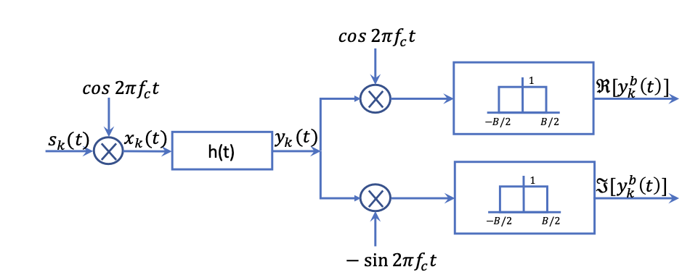
Modeling of RF Channel
How UWB module works? : transmitting pulse signal modulated by a carrier frequency
Carrier frequency
Received signal
Pulse signal
Channel state

Slide 14
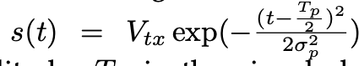
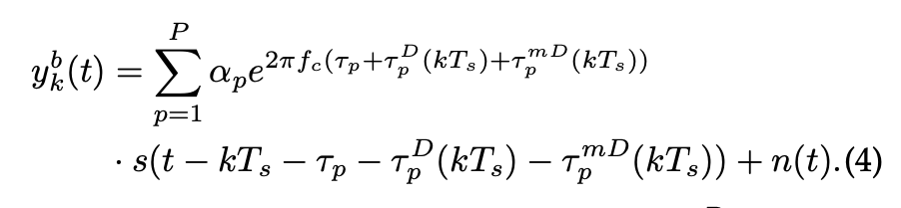
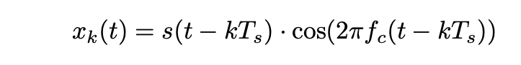
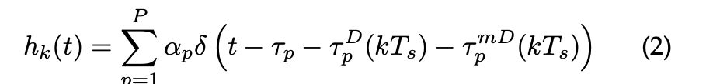
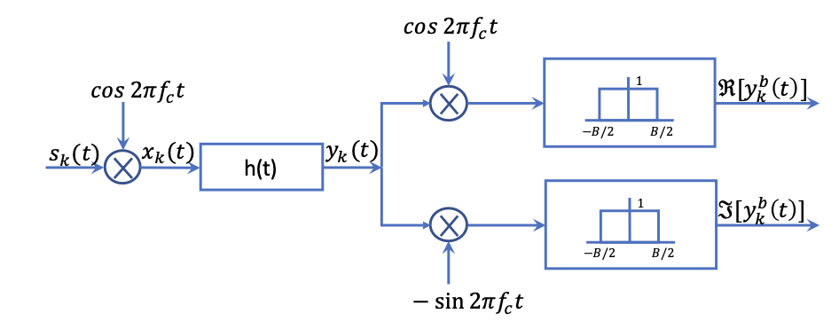
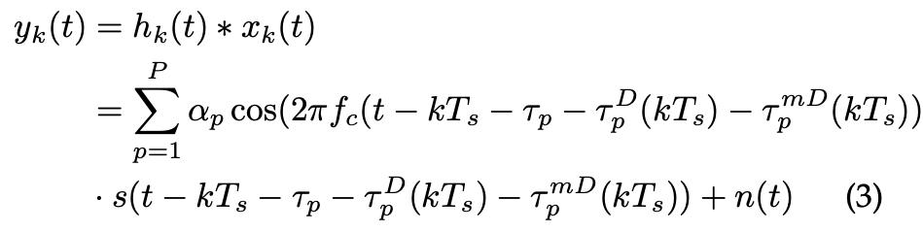
Modeling of RF Channel

Slide 15
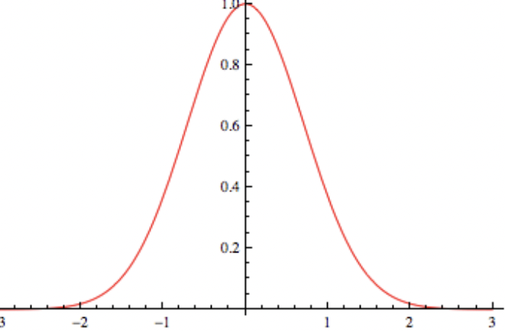
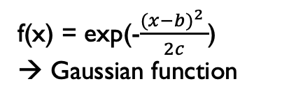
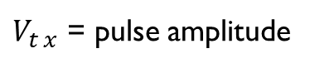
Gaussian Filter, S(t)
Filter that impulse response is a Gaussian function
f(x) = exp(-$\frac{{(x−b)}^{2} }{2c}$)
→ Gaussian function
$V_{t x}$ = pulse amplitude
→ Filtering the signal, reduce the noise of time domain, Gaussian pulse
Notes:
가우시안 필터 : 필터의 신호응답이 가우시안 함수(정규분포)의 형태를 띤다. → 신호진폭의 noise를 줄이기 위한 목적

Slide 16
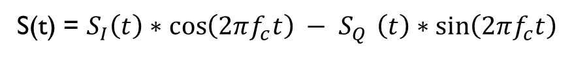
baseband signal
Baseband signal : range of frequencies occupied by signal that has not been modulated to higher frequencies
including 0Hz, a signal that must be modulated with a high frequency signal to send the original information
Consist of DC , and low frequency
S(t) = $S_{I}\left(t\right)∗\cos\left(2πf_{c}t\right) − S_{Q }\left(t\right)∗sin\left(2πf_{c}t\right)$
In – phase : energy that exist in all status
Quadrature : Exist in Dynamic Situation
Notes:
Baseband signal : 0 헤르츠를 포함하면서 높은 주파수로 변조되지 않은 신호(직류, 저주파로 구성), 가지고
있는 원본 정보를 담고 있으며 이를 전달하기 위해 고주파 신호로 변조 되어야 하는 신호
Real number part 인 in phase signal과 이와 90도 위상차이가 나는 imaginary part 인 Quadrature signal로 구성

Slide 17
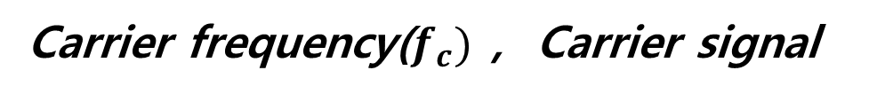
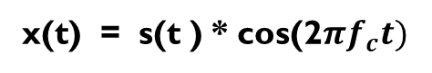
Carrier frequency($f_{c})$, Carrier signal
Carrier frequency($f_{c}$) : The central frequency used to communicate information.
Carrier Signal : Frequency used for information transport in communication using electricity
Correlation between baseband signal and carrier signal : When a carrier signal is multiplied by a baseband signal (Modulating signal), it turns into a high-frequency modulated signal (modulated signal)
x(t) = s(t ) * cos(2$πf_{c}t)$
Modulated signal
Baseband signal
Carrier frequency
Notes:
Carrier frequency(반송주파수) : 정보를 전달할 때 사용하는 중심 주파수.
Carrier signal(반송파) : 통신에서 정보를 운반하기 위해 사용하는 신호

Slide 18
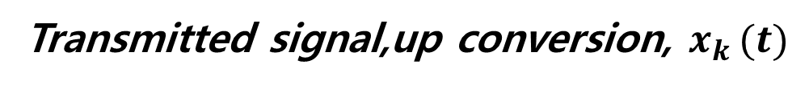
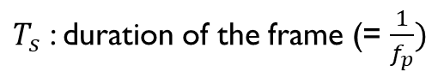
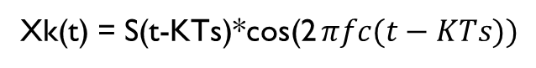
Transmitted signal,up conversion, $x_{k }(t)$
Up conversion : converting signals of low frequencies or bands into high frequencies or high frequencies
Doppler shift, time shift effect → kTs shift in time domain
K: kth frame
$T_{s}$ : duration of the frame (= $\frac{1}{f_{p}})$
Xk(t) = S(t-KTs)*cos(2 $πfc(t−KTs))$
${pulse repetation frequency(f}_{p})$ : number of pulses of a repeating signal in a specific time unit.
Notes:
IQ upconversion : baseband signal이 담고 있는 정보를 운반하고자 carrier signal(반송파 신호)을 곱하여 높은 주파수의 signa로 변조시키는 과정
Fp : 특정시간 단위로 반복되는 신호의 펄스 수

Slide 19
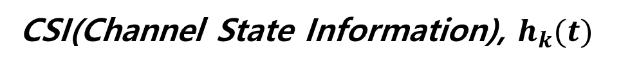
CSI(Channel State Information), $h_{k}(t)$
Channel State Information(CSI) : Information of communication channel
In mobile communication, change of channel state is very fast
For efficient and stable network, require to report channel status
Sum until Pth reflection path signal
$$α_{p}:Propagation attenuation in Pth path.$$
Why using delat function? : modeling signal in specific time
Notes:
channel(채널) : 정보를 시간 및 공간적으로 전달하는 한정된 path(통로)
전체 채널상태(h(t)) : 첫번째부터 p번째 path 까지의 surmation으로 생성됨
알파 → propagation attenuation: attenuation = 다양한 손실 요인에 의해 신호 전력이 약화되는 현상

Slide 20
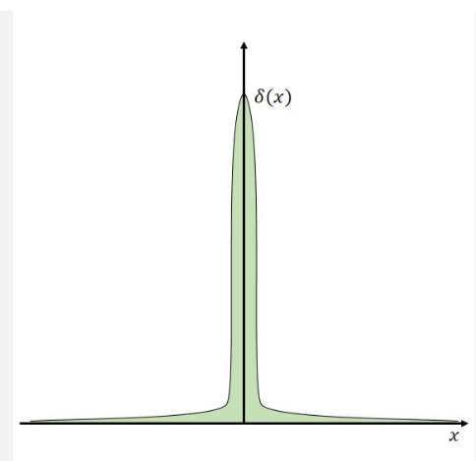
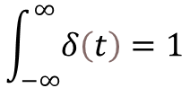
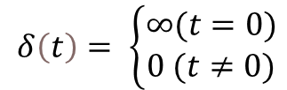
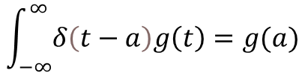
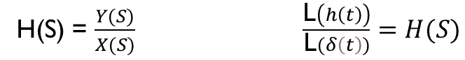
Dirac delta function, transfer function
Feature of dirac delta function
$$\int_{−∞}^{∞}{δ\left(t−a\right)g\left(t\right)=g(a)}$$
$$δ\left(t\right)= \left\{\begin{aligned}∞(t=0) \\ 0 (t≠0)\end{aligned}\right.$$
$$\int_{−∞}^{∞}{δ\left(t\right)=1}$$
Transfer function
H(S) = $\frac{Y(S)}{X(S)} \frac{\text{L}\left(h\left(t\right)\right)}{\text{L}(δ\left(t\right))}=H(S)$
Why using delta function? : modeling signal in specific time

Slide 21

CSI(Channel State Information) , Convolution
CSI(Channel State Information) : Information of communication channel
In mobile communication, change of channel state is very fast
For efficient and stable network, require to report channel status
Convolution : A mathematical operation that multiplies one function with another by its inversion and then integrates it over an interval to obtain a new function
(usually in sampling of signal)
Notes:
CSI -- > 이동통신에서 채널상태의 변화가 매우 빠름, 채널의 상태를 기록하는 것이 필요
합성곱 : 한 함수(f($τ$)) 또 다른 함수(g($τ$)) 를 반전시킨후(g(-$τ$)) t만큼 이동한 함수(g($t−τ))$를 구한 후, 둘을 곱해서 적분하는 연산,변화의 결과를 기록(이산함수의 경우 intergration이 아닌 surmation으로 표시), 주로 신호의 샘플링에 사용됨
한 함수를 고정시켜놓고 → 또 다른 함수를 평행이동 해가면서 2개의 함수가 겹쳐질때 나타나는 면적의 변화를 기록 / 면적 = convolution얀산의 값

Slide 22
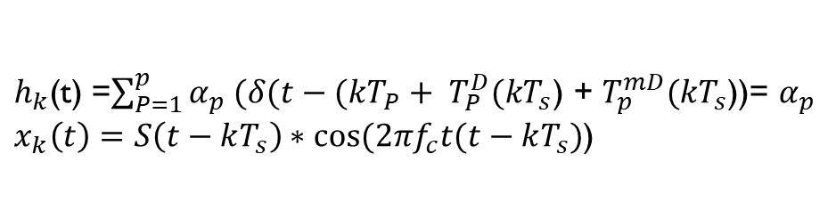
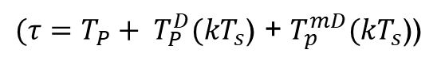
$(τ=T_{P}+ T_{P}^{D}(kT_{s}$) + $T_{p}^{mD}(kT_{s}$))
$h_{k}$(t) =$\sum_{P=1}^{p}{α_{p} (δ(t−(kT_{P}+ T_{P}^{D}(kT_{s}\text{) + }T_{p}^{mD}(kT_{s}\text{))}}$= $α_{p}$
$x_{k}\left(t\right)=S\left(t−kT_{s}\right)∗cos⁡(2πf_{c}t(t−kT_{s})$)
$x_{k}(t−τ$) = $S\left(t−kT_{s }−T_{p }−T_{P}^{D}(kT_{s}\text{) }−T_{p}^{mD}(kT_{s}\right))∗cos⁡(2πf_{c}t(t−kT_{s}−T_{p }−T_{P}^{D}(kT_{s}\text{) }−T_{p}^{mD}(kT_{s})$)

Slide 23
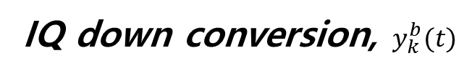
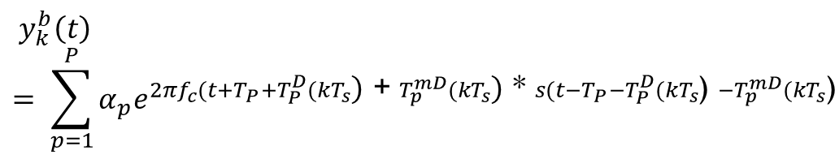
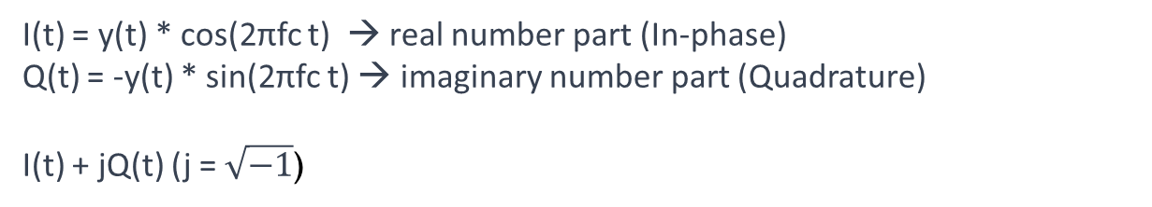
IQ down conversion, $y_{k}^{b}(t)$
IQ down conversion : Converts complex iQ signals to baseband signal or intermediate signal
Intermediate signal(IF) : Intermediate level of high frequency converted signal(RF band) and law frequency baseband signal
I(t) = y(t) * cos(2πfc t) → real number part (In-phase)
Q(t) = -y(t) * sin(2πfc t) → imaginary number part (Quadrature)
I(t) + jQ(t) (j = $\sqrt{−1}$)
$${ y}_{k}^{b}\left(t\right) = \sum_{p=1}^{P}{α_{p}e^{2πf_{c}{(t+T}_{P}+T_{P}^{D}(kT_{s}\text{)}\text{ + }T_{p}^{mD}(kT_{s}\text{)}\text{ ∗ }s({t−T}_{P}−T_{P}^{D}(kT_{s}\text{) }−T_{p}^{mD}(kT_{s}\text{)}}}$$
Notes:
Iq downconversion : 복소수 형태의 변조 신호를 다시 baseband signal이나 intermediate signal로 변환시키는 과정
Intermediate signal(중간주파수) : carrier signal에 의해 변조된 고주파 신호와(RF band) 원본 신호인 baseband signal 의 중간 정도 수준의 신호

Slide 24
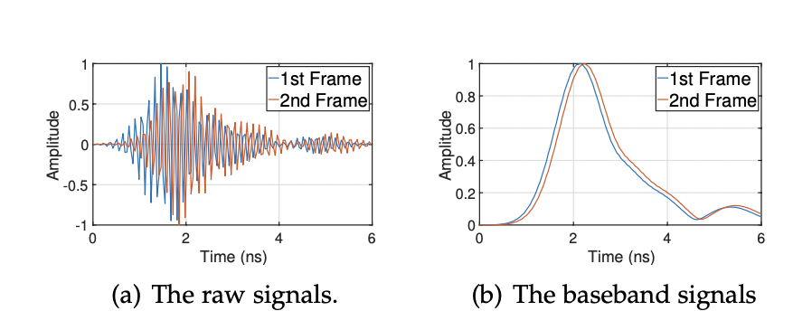
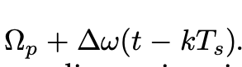
Processing RF Signals-1
1. Phase noise reducing
ADC(Analog Digital Converter) → Sampling Timing Offset(STO), imperfect sampling time
Doppler , Micro Doppler(change of Doppler effect) information
Statistic object → Doppler ,Micro Doppler = 0
Second baseband signal has jitter(phase distortion)
Raw signal : signal that is not manipulated(frequency modulation etc..)

Slide 25
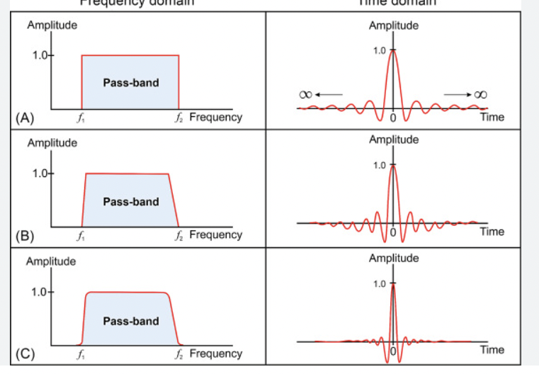
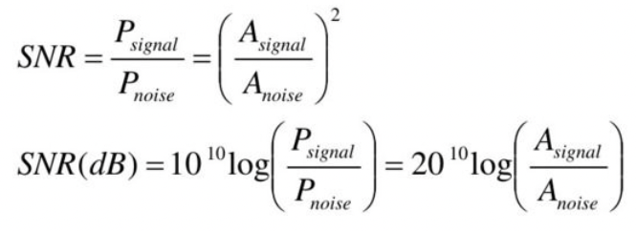
Processing RF Signals-2
2.SNR(Signal to Noise Raito) Enhancement
Raw receiving signal → brings in error in the neural network model → overfitting
→ Solution : Cascading filter, Low-pass-filter, smoothing filter
Low Pass Filter
Formula of SNR

Slide 26
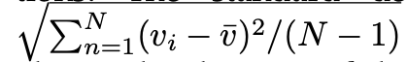
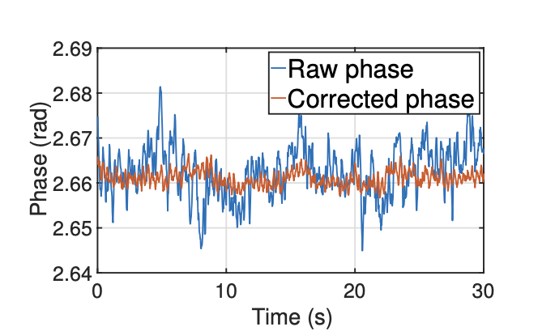
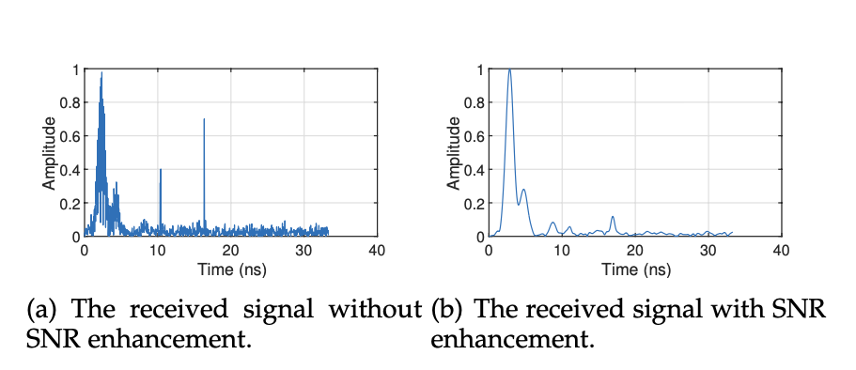
Processing RF Signals-3
3.Motion Detection(in portable situation)
The standard deviation

Slide 27
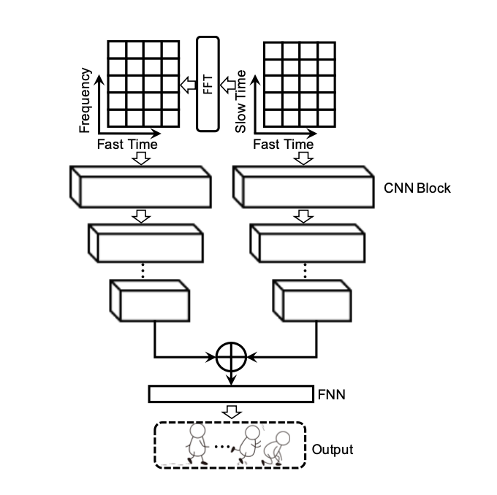
Signal Adapted Convolution Neural Network
Make CNN model aggregate information from both time and frequency
Extract the features for different activities
Put time and frequency in different channels of image
Each CNN block output is followed by an activation function ReLu(f(x) = max(0,x))
Connect two layers , FNN(Feed forward Neural Network)
Prediction → softmax function

Slide 28
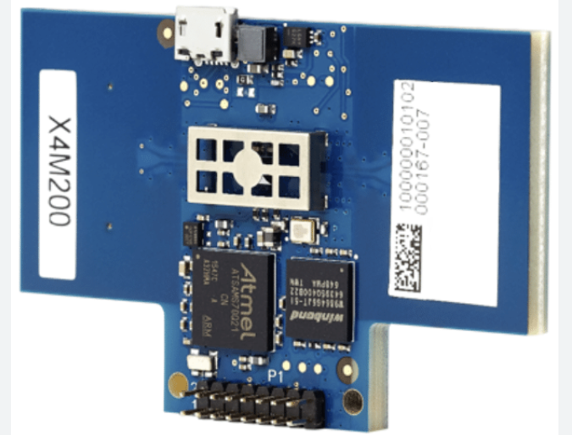
Implementation and Evaluation
Implementation
Hardware : cheap commodity UWB radio XETHR
→ Transmit and receive UWB signal
Evaluation
Test data(5 environment), Training data(2 environment) → collect data from 7 different environment
Training sample(15000), Testing sample(40000)

Slide 29
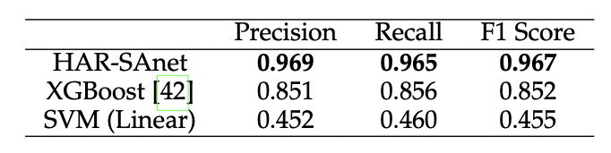
Activity Recognition-impact of model
How to emulate a real scenario?
Kernel size : 3 x 3 kernel
HAR-SAnet : Convolution Neural Network based deep learning model that recognize human’s activity
XGBoost, SVM : Not based on Neural Network
Recall = TP / TP + FP
F1 score = sensitivity of the model

Slide 30
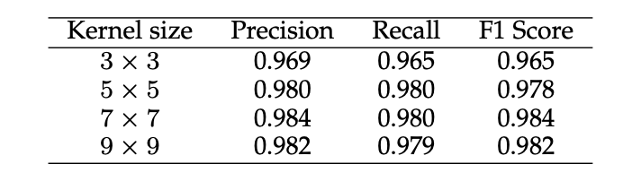
Activity Recognition-impact of kernel sizes
Impact of kernel sizes on HAR-Sanet.
In 9 x 9 kernel Precision start to decrease → receptive field is too large, capturing useless noise

Slide 31
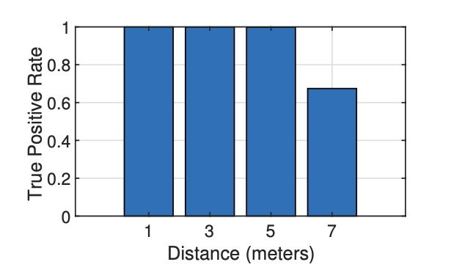
Motion Detection
How to evaluate the accuracy of motion detection?
True Positive Rate(TPR) : ratio of HAR-SAnet correctly detects the human motion
False Alarm Rate(FAR) : ratio of HAR-SAnet detects the human motion wrong

Slide 32
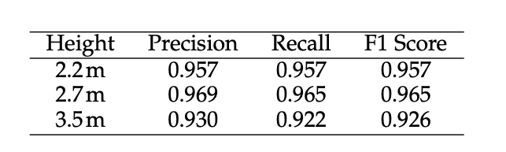
Activity Recognition-impact of height
3 x 3 kernel

Slide 33


Comparison with other models(Complexity, Energy, Accuracy)
CNN computing is not only determined by the computing operations, but also by memory swap
tCNN spends more time in memory swap than the other blocks

